Slide 1
🤝 Bayanihan Hub
🏷️ Project Theme: Equalizing an Unbalanced Society
Trisha Dacumos
Jehosue Biscarra
Christopher Buen
Leah Joyce Caoile
Laurice Mae Ancheta

Slide 2
Introduction
A Bayanihan Hub is a community platform where people can donate items, request assistance, and exchange goods with one another. The project aims to address the issue of social inequality by promoting a culture of sharing and mutual support. Through this platform, individuals will have free and equal access to essential resources regardless of their financial status. By encouraging community participation the project helps reduce waste, support those in need, and provide a more inclusive and balanced society.
Jehosue

Slide 3

LOGO
Bahay Kubo – Represents the Filipino culture of Bayanihan, symbolizing unity, hospitality, and a community where people work together to help one another.
Heart, Hands, and Box – The heart signifies compassion and kindness, the handshake represents trust and cooperation, while the box symbolizes the donation, exchange, and sharing of resources within the community.
People and Supporting Hands – The two human figures on each side represent members of the community helping one another, while the hands beneath them symbolize support, care, and collective effort in uplifting those in need.

Slide 4
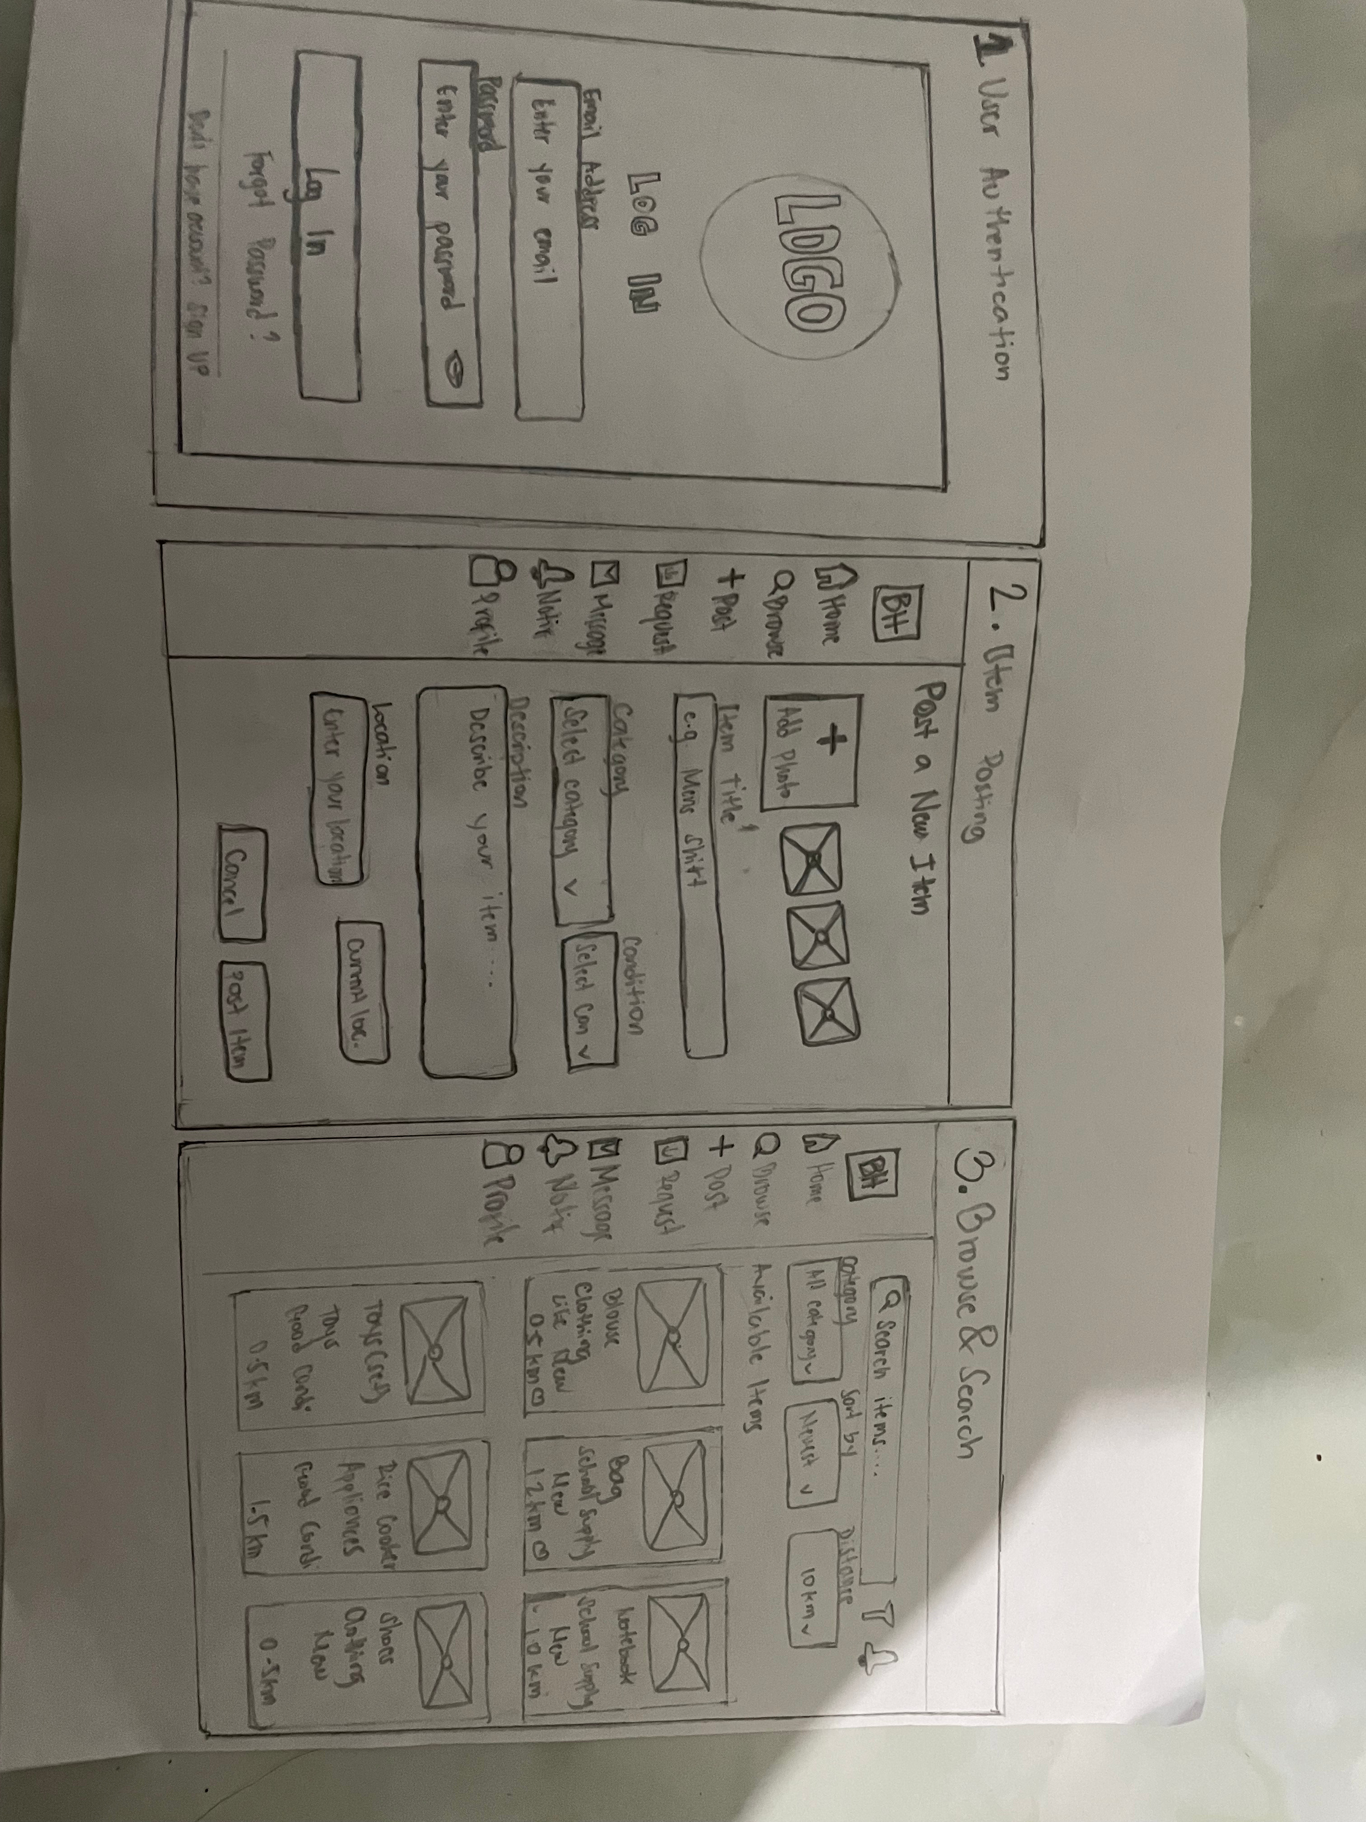
LOW FIDELITY

Slide 5
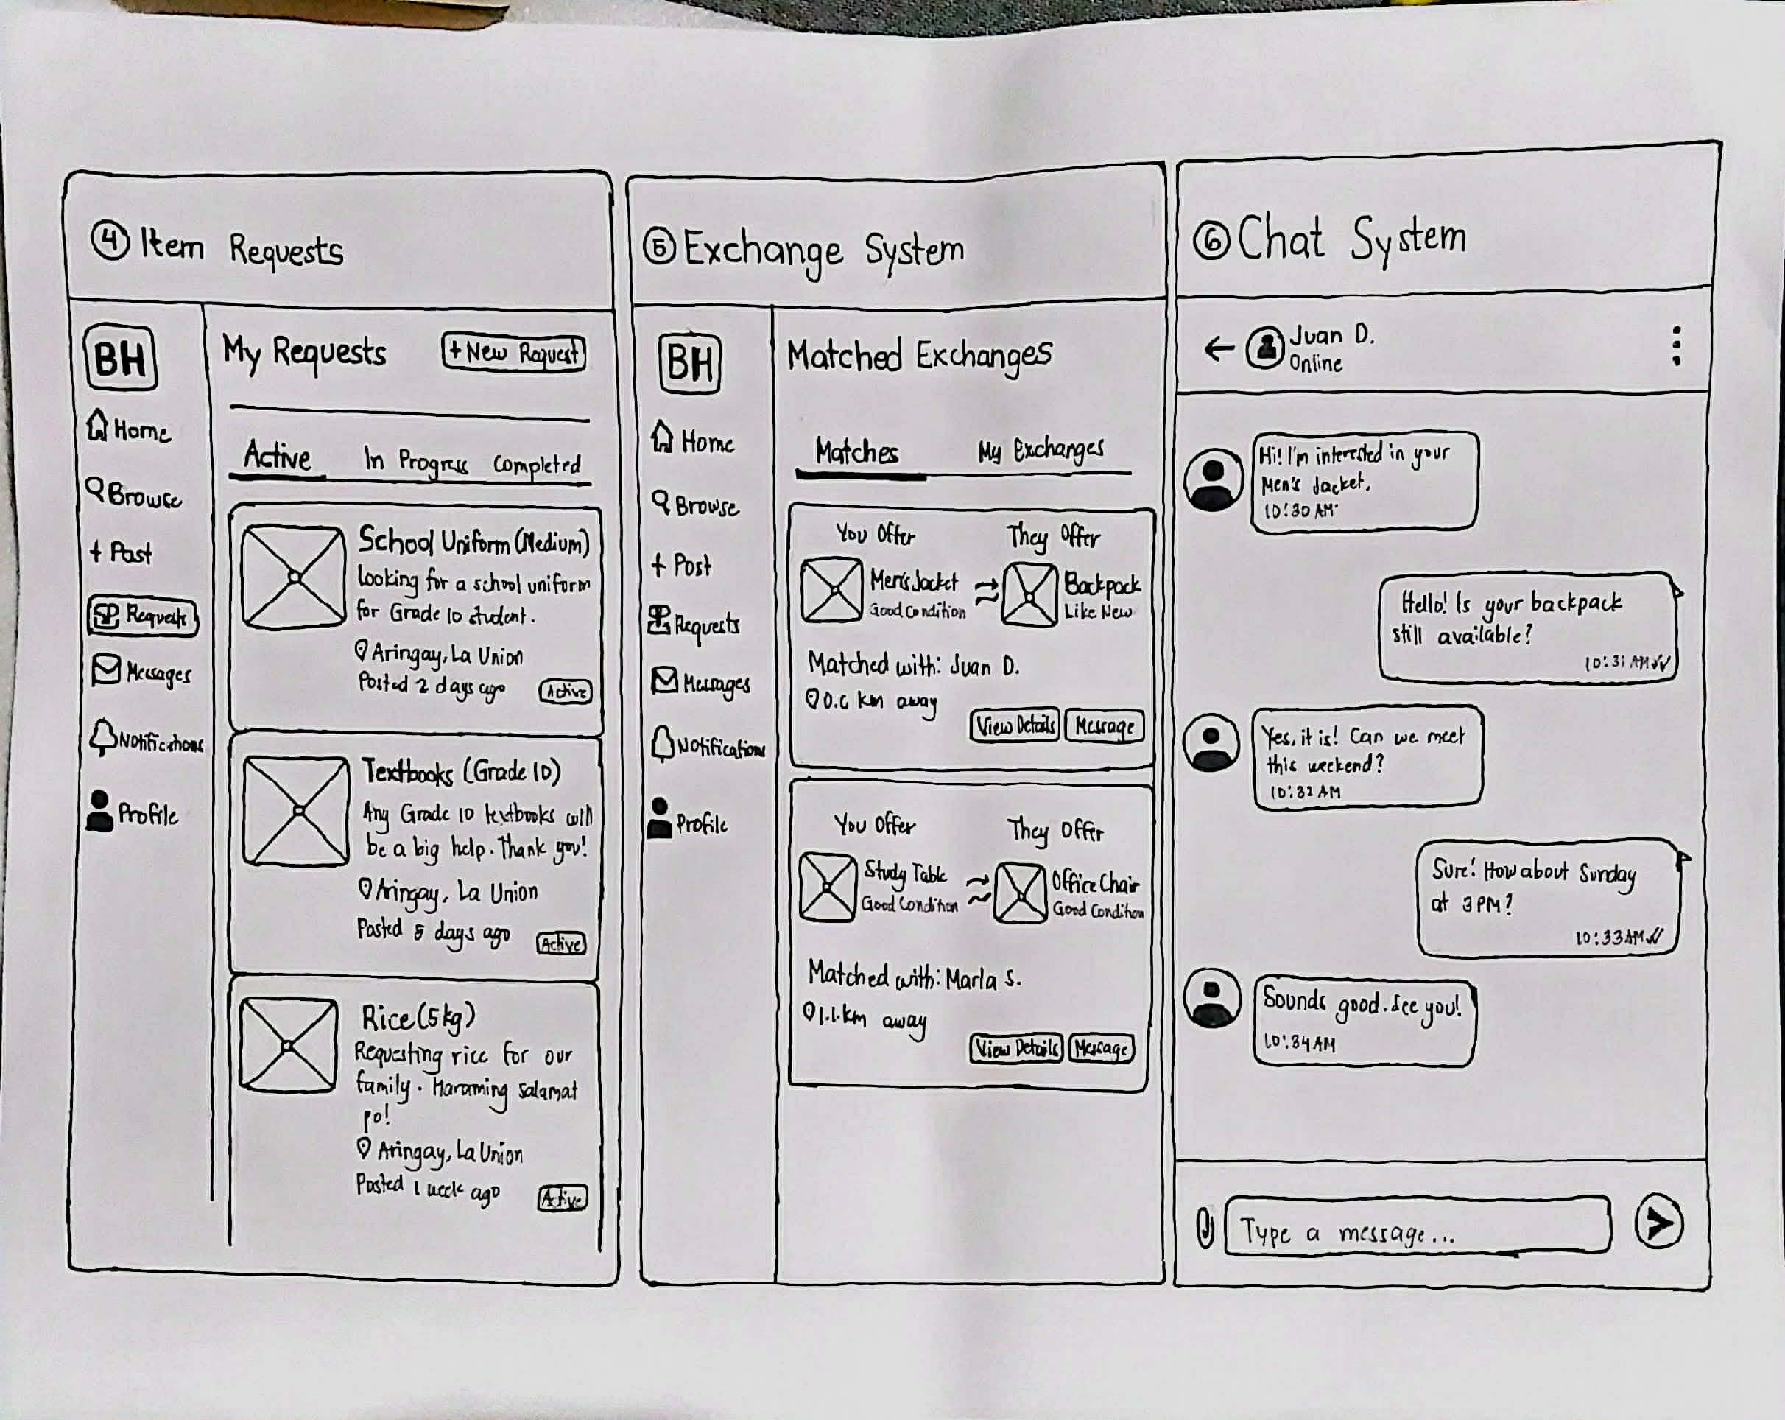
LOW FIDELITY

Slide 6
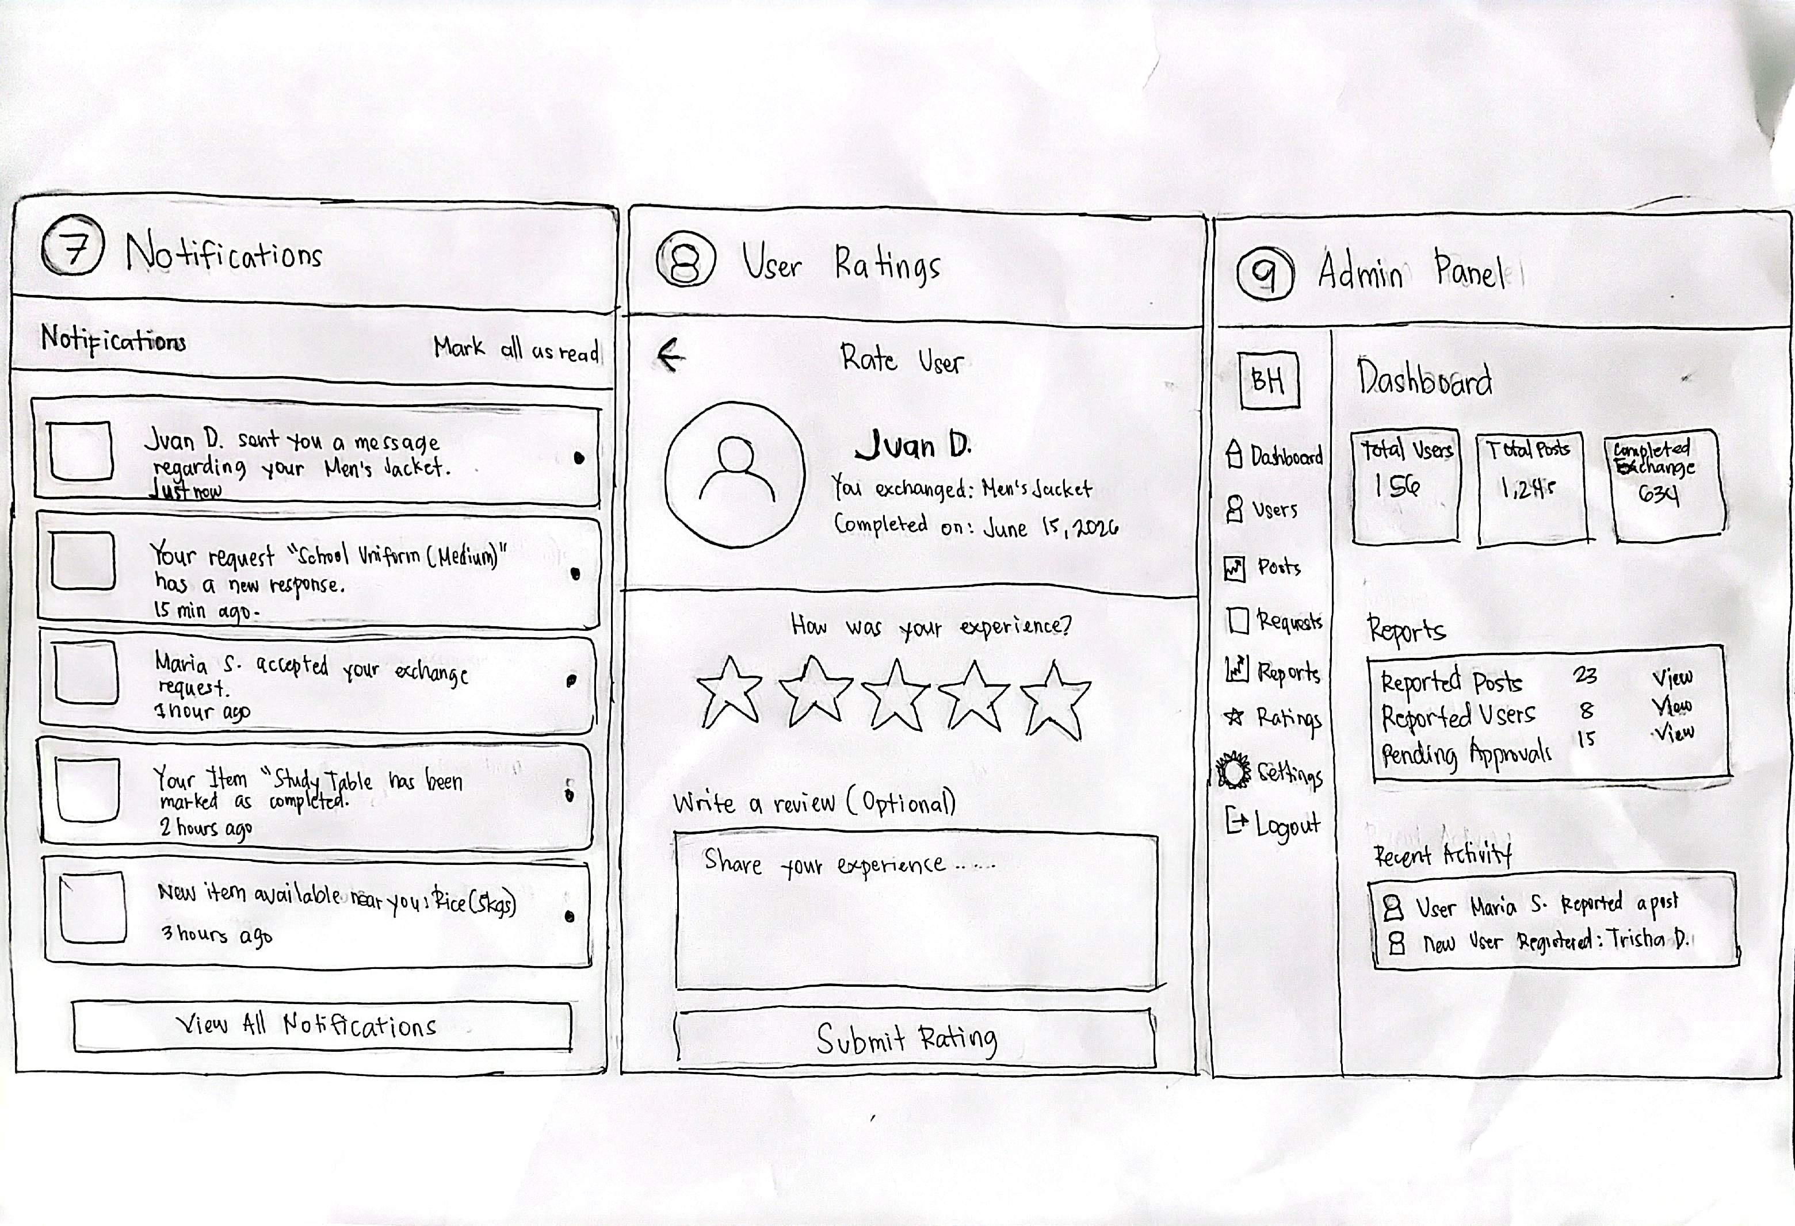
LOW FIDELITY

Slide 7
Methodology
Who is our participants?
IT Specialist: AM Mc Bryan C. Amen PAF
End User: SGT. Larjollene A. Dimaculangan PAF, FO1 Reynald B Carolino
Main Client: Brgy. Captain Lauro A. Ancheta
Why they were chosen?
They were chosen because the Main Client and End-User will directly benefit from this project. Also, they are all from the municipality of Tubao.
Jehosue

Slide 8
Methodology
How they were recruited?
We recruit the I.T Specialist by recommendation from our end-user.
The Main Client and End-user are related to one of our member.
Where they were interviewed?
The IT Specialist was interviewed online through Zoom. Meanwhile, the main client and end-users were interviewed face-to-face.

Slide 9
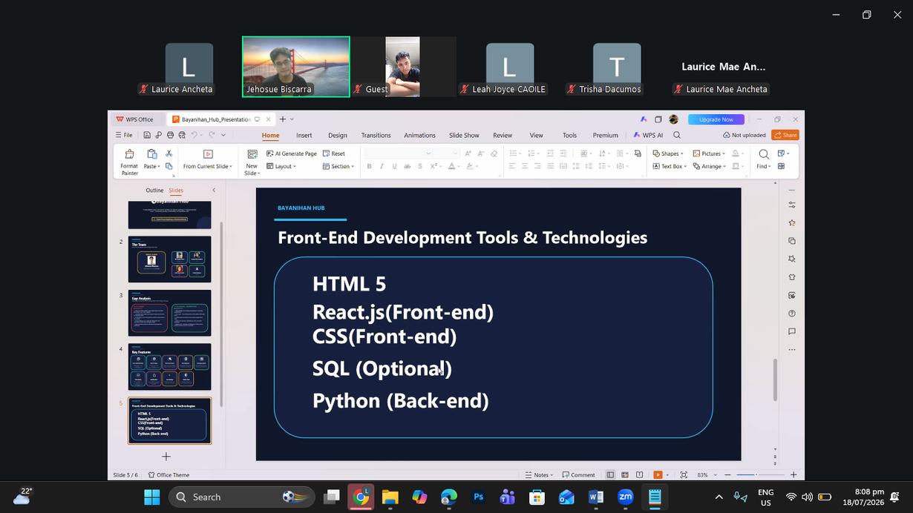
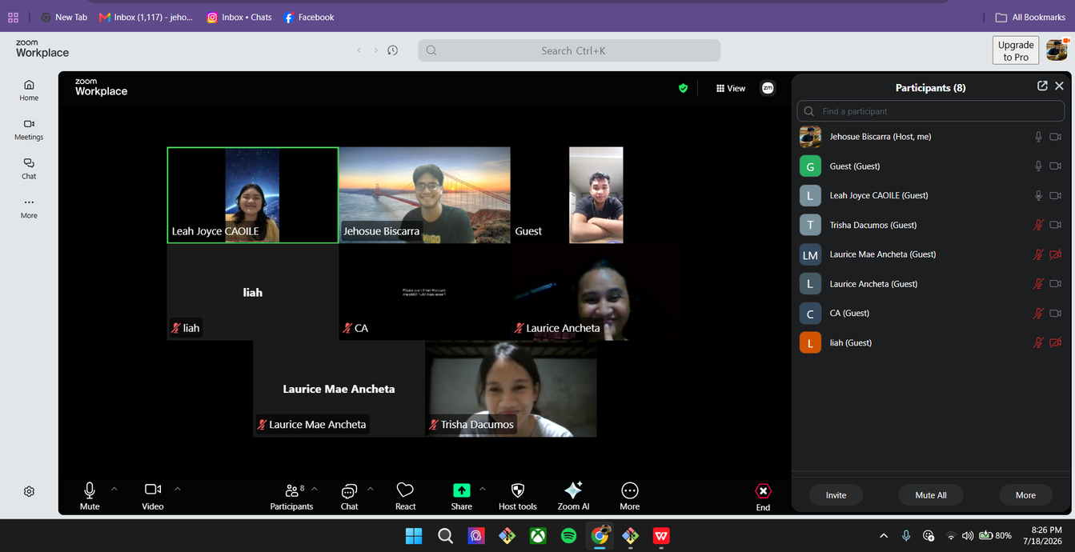
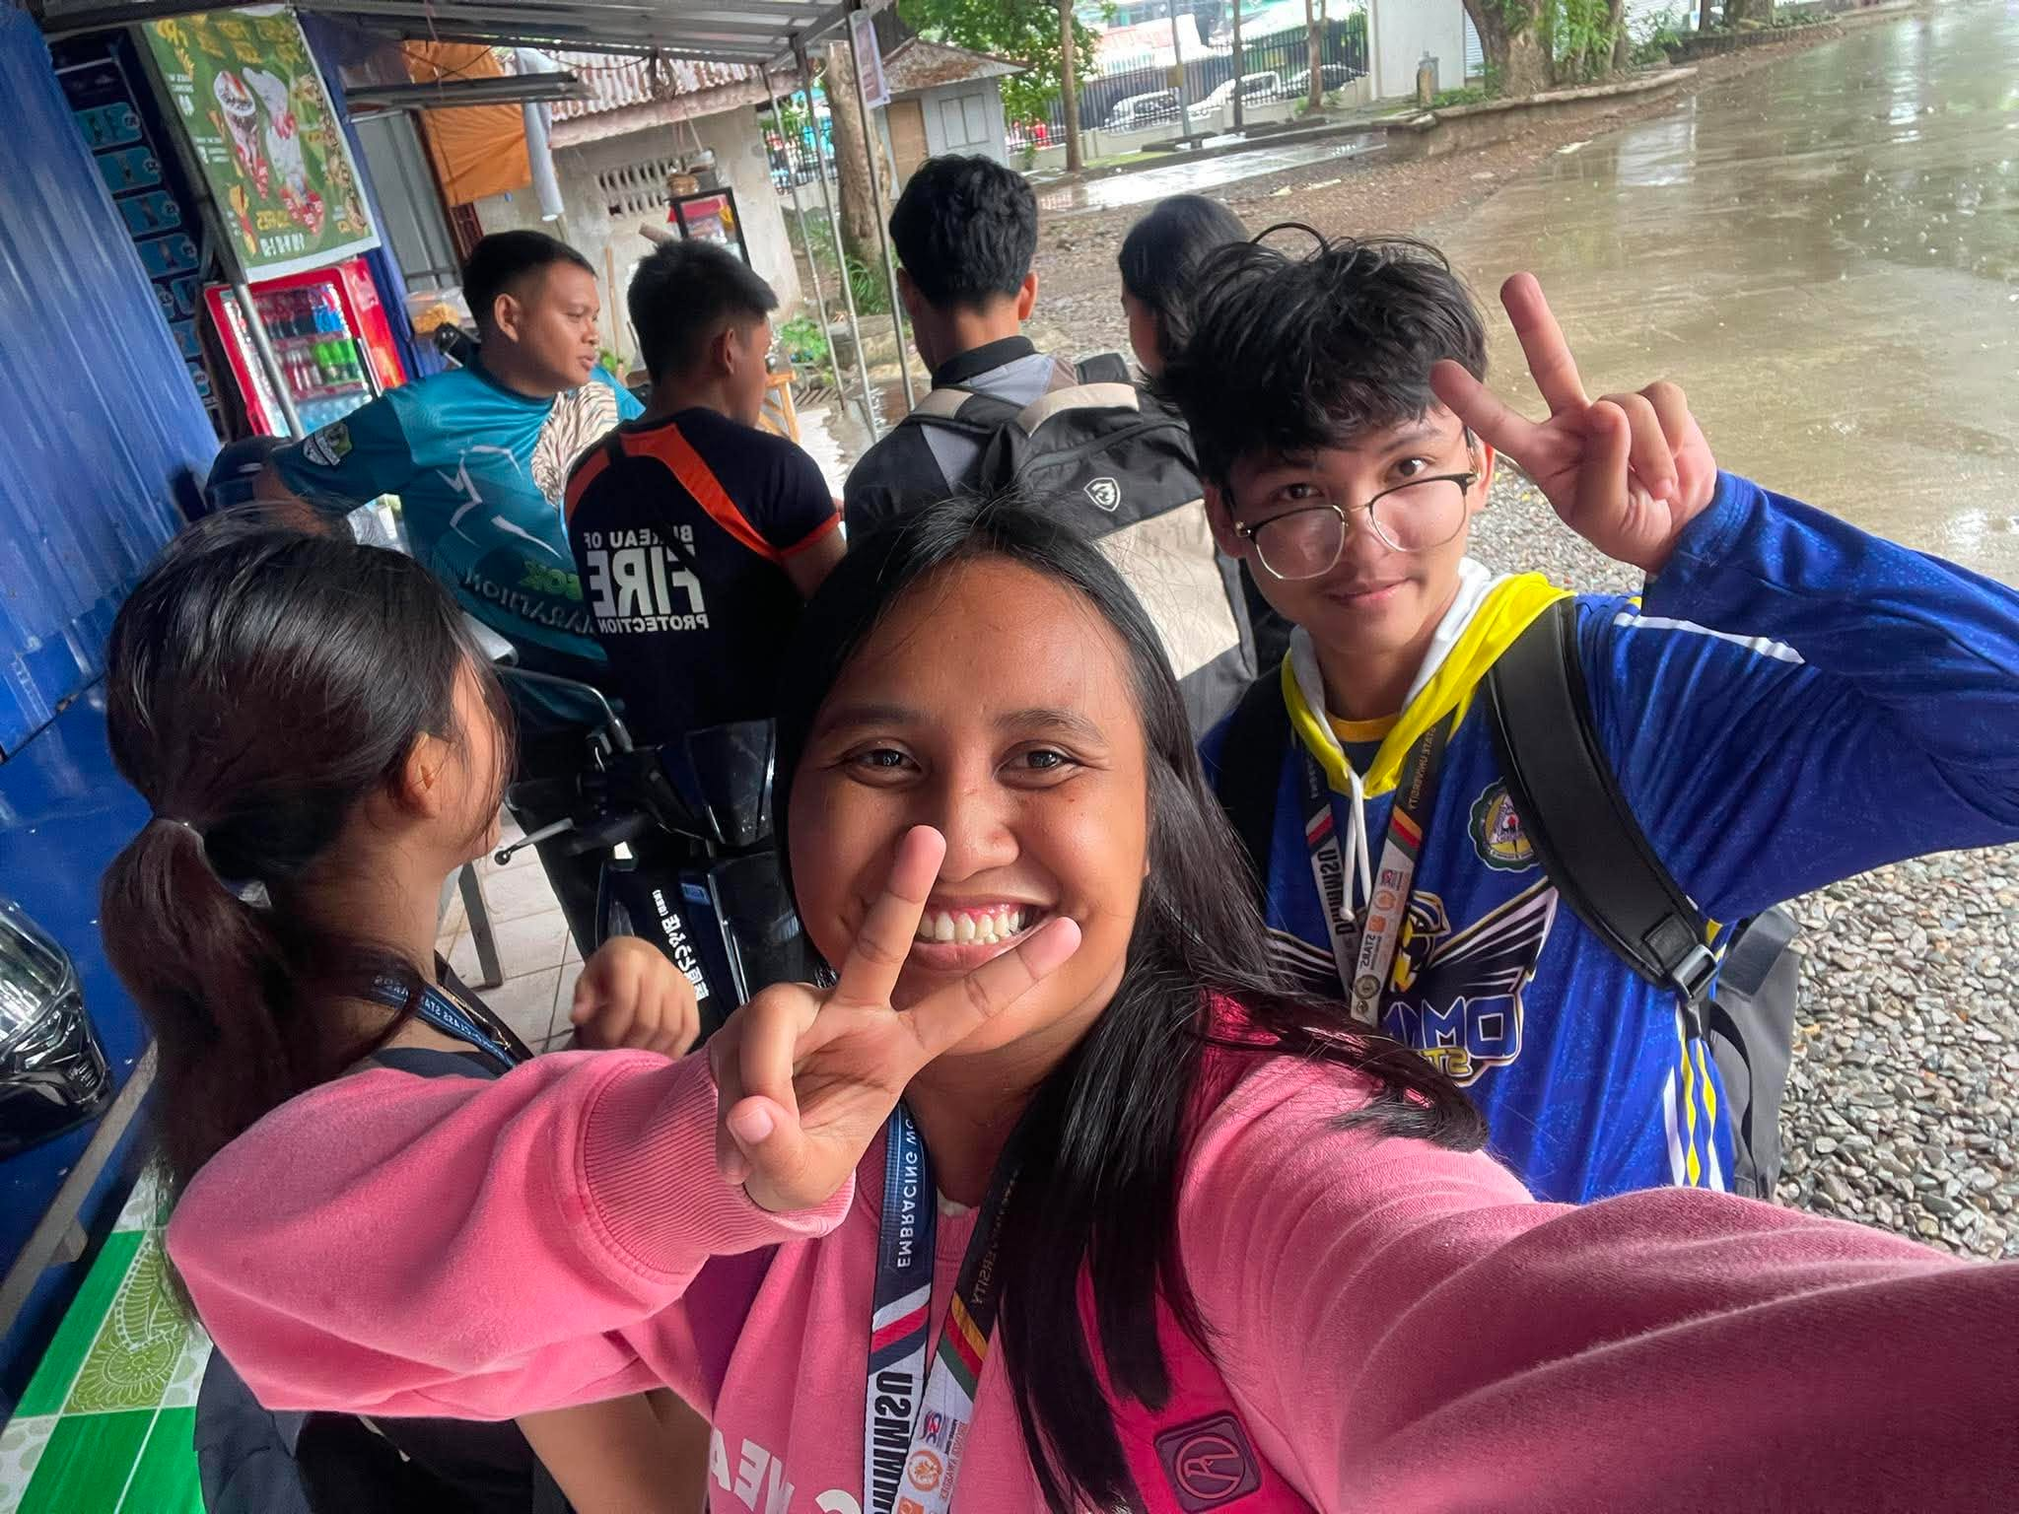
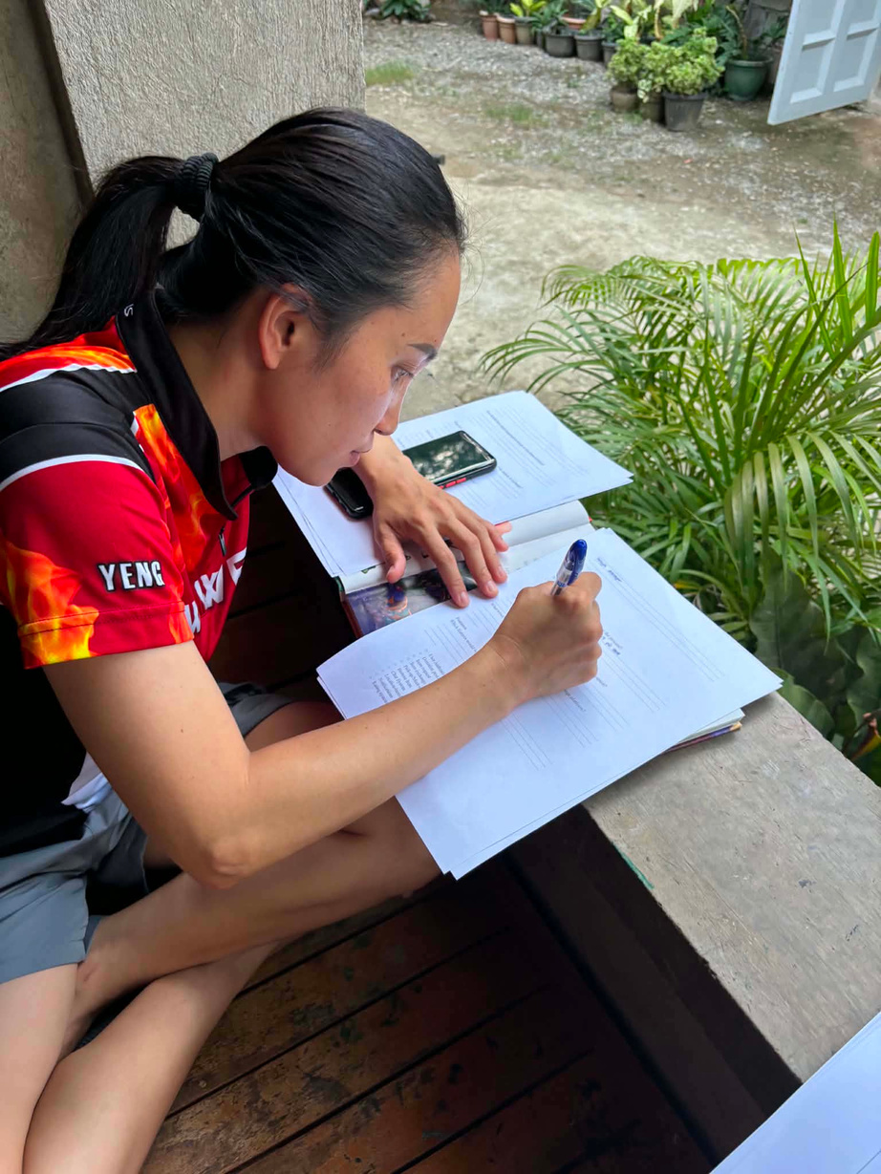
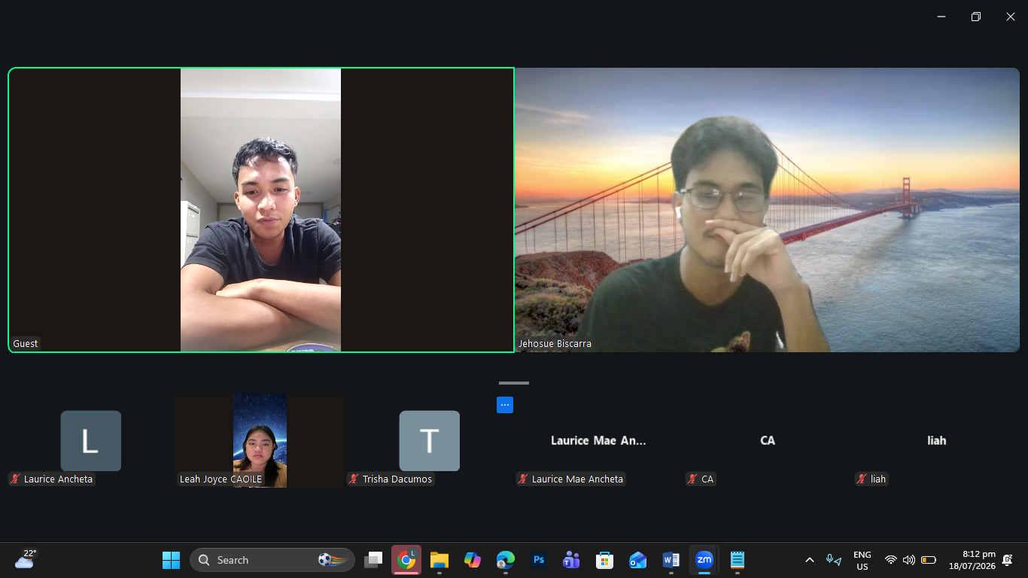
DOCUMENTATION

Slide 10

IT SPECIALIST
Laurice
QUESTIONS ANSWERS
What did you ask?
What technologies would you recommend for developing this web platform?
Gumamit ng mga teknolohiyang pamilyar ang development team. Maaari ang MySQL bilang database ngunit mas maganda maghanap ng mas secure na alternatibo like. JavaScript ang maaaring gamitin sa system at security features, at maaaring lagyan ng AJAX para sa mas maayos at mabilis na data processing.
What authentication and security mechanisms should be implemented to protect user accounts and personal information?
ArangoDB
What measures should be implemented to detect fraudulent activities, fake accounts, and inappropriate content?
Humingi ng valid credentials o IDs sa paggawa pa lamang ng user account upang ma-verify ang pagkakakilanlan ng mga gumagamit at makatulong sa pag-detect ng mga pekeng account.

Slide 11
IT SPECIALIST
Laurice
QUESTIONS ANSWERS
What did you ask?
What database structure would best manage donations, requests, and exchanges?
I Recommend ArangoDB para sa mas mahusay na database management, ngunit maaari pa ring gumamit ng MySQL kung limitado ang resources ng development team niyo.
How should the system store and manage item listings, images, user requests, and exchange records efficiently?
I-categorize ang mga item listings tulad ng damit at appliances upang maging maayos at user-friendly ang sistema. Mainam din na gumamit ng filtering features gamit ang JavaScript upang mas mapadali ang paghahanap ng mga item.
What usability principles should be followed to ensure a user-friendly interface?
Dapat unahin ang pangangailangan ng target users sa disenyo ng system. Mahalaga ang pagkuha ng kanilang mga rekomendasyon at feedback upang matiyak na madaling gamitin at makatutulong ang platform sa kanilang pangangailangan.

Slide 12
IT SPECIALIST
Laurice
QUESTIONS ANSWERS
What did you ask?
Needs ng target users at ang maayos na pamamahala ng data. Inirerekomenda ko ang pagkakaroon ng admin dashboard na may export-to-Excel feature para sa inventory management, ratings, at mga reports ng users.
What challenges do you foresee in developing this platform?
How can the platform remain scalable as the number of users increases?
Dapat patuloy na i-update at i-debug ang system upang maiwasan ang mga errors. Maganda ang paglim account creation at login attempts upang maiwasan ang sobrang traffic sa database kapag dumadami ang users.
Isagawa ang user testing sa pamamagitan ng pagpapagamit ng system sa mga target users upang matukoy ang mga kakulangan ng platform at ma-improve bago ito i-deploy.
What testing methods should be conducted before deployment?
Can you share your recommendations to improve the overall system?
Kailangan updated at secure ang system at tiyaking user-friendly ito

Slide 13
MAIN CLIENT
Leah
QUESTIONS ANSWERS
What did you ask?
What challenges do you currently face in distributing or managing donated essential items?
Mahirap minsan ang maayos na pagbibigay ng donations dahil hindi agad namin nalalaman kung sino yung mga mas nangangailangan. May mga time din na kulang yung information ng tatanggap o may mga nakakakuha nang higit sa isang beses.
What types of essential items are most commonly donated or requested?
Kadalasang donasyon o hinihingi ay yung basic needs kagaya ng bigas, de-lata, damit, school supplies, hygiene kits, gamot. Kapag may kalamidad, kailangan din minsan ang kumot at electric fan.
How do you currently verify legitimate donors and recipients?
Humihingi kami ng valid ID para masigurong residente sila ng barangay. Nakikipag-usap din kami sa mga barangay officials para malaman kung sino ang tunay na nangangailangan. Sa mga donor naman, kinukuha namin ang kanilang pangalan at contact number.

Slide 14
MAIN CLIENT
Leah
QUESTIONS ANSWERS
What did you ask?
What features would you like to see in a donation and exchange web platform?
Maganda kung may user verification, tracking ng donasyon, notifications, at listahan ng mga kailangan ng barangay. Makakatulong din kung puwedeng mag-upload ng pictures ng mga idodonate.
How important is transparency in tracking donations?
Napakahalaga ng transparency para makita kung saan napupunta ang mga donasyon at mapanatili ang tiwala ng mga donor at recipient.
What problems do you want this platform to solve?
Sana matulungan ng platform na maging fair ang pamamahagi ng donasyon at mas maayos ang pagtatala ng mga ito.
How should users report inappropriate listings or fraudulent activities?
Dapat may "Report" button sa bawat post para madaling mai-report ang mga peke o mapanlinlang na gawain

Slide 15
MAIN CLIENT
Leah
QUESTIONS ANSWERS
What did you ask?
What information should be required when posting a donation, request, or exchange?
Dapat ilagay ang pangalan, contact number, lokasyon, uri ng item, dami, kondisyon nito, at larawan ng item.
What indicators would make you consider the platform successful?
Kung mas maraming natutulungan at mas mabilis na natatanggap ng nangangailangan ang mga donasyon.
Do you have any additional suggestions for improving the platform?
Makabubuti kung makikipagtulungan ang platform sa mga barangay para sa mas madaling pag-verify ng mga recipient. Dapat simple at madaling gamitin ang sistema para sa lahat

Slide 16
END USER
Trisha
QUESTIONS RESPONDENT
What did you ask?
Have you ever donated, requested, or exchanged essential items?
Yes, donated.
What platform or method did you use?
Through messenger
What difficulties did you experience during the process?
Some stuffs like clothes or shoes doesn't fit them
What types of essential items would you most likely donate or request?
Clothes and Shoes

Slide 17
END USER
Trisha
QUESTIONS RESPONDENT
What did you ask?
What would encourage you to use an online donation and exchange platform?
Easier access when there are available items I need as well as when there is something I want to donate / exchange.
Which features would be most useful? Explain why.
All features especially the notifications because if some posted an item all users will be notified
What details should be included in an item posting.
Specifications of an item, expiration date of foods,and flaws should also be included so that everyone can see if it needs repair.
How would you like the Chat System to support communication and negotiation between users?
Feature like one-tap templates like "Is this still available?" and allow users to upload photos, videos or documents

Slide 18
END USER
Trisha
QUESTIONS ANSWERS
What did you ask?
How would you prefer to search for items (e.g., category, location, condition, availability)?
Can be filtered by category, location, condition and availability for easier browsing
What additional features would improve your experience?
None, so far

Slide 19
END USER
Trisha
QUESTIONS RESPONDENT
What did you ask?
Have you ever donated, requested, or exchanged essential items?
Financial Assistance
What platform or method did you use?
Funds allocated for buying relief items such as rice and canned goods
What difficulties did you experience during the process?
Flood
What types of essential items would you most likely donate or request?
Rice, canned goods and basic needs

Slide 20
END USER
Trisha
QUESTIONS RESPONDENT
What did you ask?
What would encourage you to use an online donation and exchange platform?
None
Which features would be most useful? Explain why.
All features, except the browse and pick-up/meet-up. No to face to face.
What details should be included in an item posting.
Basic need, Yero, and Clothing
How would you like the Chat System to support communication and negotiation between users?
Most likely

Slide 21
END USER
Trisha
QUESTIONS ANSWERS
What did you ask?
How would you prefer to search for items (e.g., category, location, condition, availability)?
category, location, condition and status
What additional features would improve your experience?
Request verification of situation(picture, video).

Slide 22

EMPATHY MAP
Leah
SAY
THINKS
User-friendly platform
Transparent process
User testing before deployment
Customer is always right
Easy to use
Fair and honest system
Well-tested platform
User needs matter
FEELS
DO
Comfortable using the system
Trusts the process
Confident in the platform
Valued as a user
Uses platform features
Tracks donation status
Participates in testing
Provides feedback

Slide 23
Analysis
Christoper
The responses consistently indicate that the proposed system addresses existing inefficiencies by improving accessibility, simplifying tasks, and providing a more organized workflow. they also emphasized the importance of user-friendly design, security, and system reliability, suggesting that the application has the potential to improve operational efficiency while remaining easy to maintain.

Slide 24
Conclusion
Christoper
The interview results shows that the proposed system is effective in meeting the needs of its intended users. Feedback from the IT Specialist, Main Client, and End User indicates that the system is practical, easy to use, and capable of improving the efficiency of existing processes. Although there improvements may still be made based on user feedback, the overall evaluation shows that the system is feasible for implementation. Therefore the proposed system successfully addresses the identified problems and has the potential to provide a reliable, efficient, and user-friendly solution.

